Slide 1

Financial Risk Management
Spring 2016
Dr. Ehud Peleg
Volatility Models

Slide 2
Agenda
Managing Traded Market Risk
Volatility Models
Exponentially Weighted Moving Average
GARCH (1,1)
Forecasting Volatility
Scenario Analysis - Volatility Shocks

Slide 3

Rogue Trader
Barings was UK’s oldest merchant bank.
Leeson managed the Singapore Trading Desk.
In 1992, he made 10% of Barings profit.
By 1995, He made total losses of $1.4B
Chief trader and responsible for settling the trades.

Slide 4
Risk Management of Trading in Financial Institutions
Front Office – Take on risk as Market Makers or as Proprietary Traders
Take risk according to view and within risk limits
Middle Office – Manages market and operational risk of the trading floor
Aggregate risk
Control risk limits: internal and regulatory
Back Office – Record keeping, manage execution and control operational risks

Slide 5
Trading Market Risk
Trading market risk managers typically look at daily returns.
Define u_{i} as (S_{i}−S_{i-1})/S_{i-1}
Assume that the mean value of u_{i} is zero
Returns and log-returns are very close
We are interested in determining the expected volatility for the next day.
If returns are i.i.d, use m last days to estimate volatility:

Slide 6
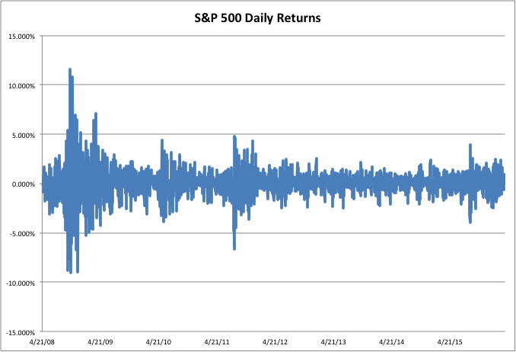
High volatility
Low volatility

Slide 7
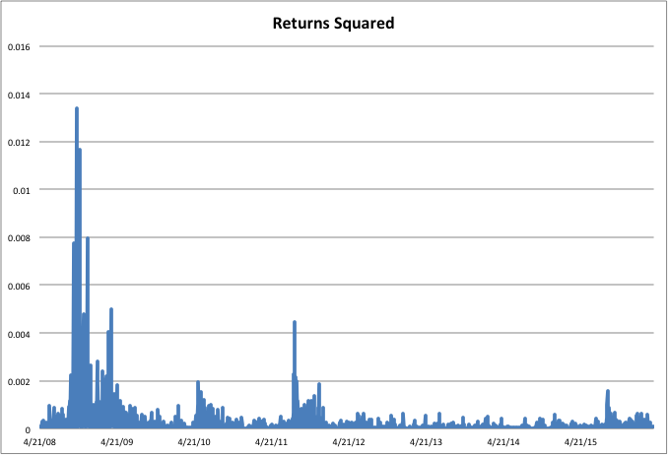

Slide 8
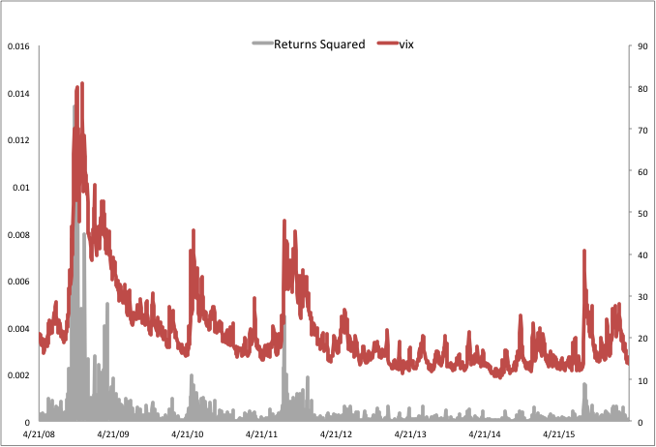

Slide 9
Some Stylized Facts
Returns are not i.i.d. but show very little serial correlation.
Squared returns, or volatilities, show high serial correlation.
Return series is heavy tailed.
High volatility, and extreme events, appear in clusters.

Slide 10
EWMA Model
In an exponentially weighted moving average model, the weights assigned to the u² decline exponentially as we move back through time
This leads to
RiskMetrics uses λ = 0.94
Tracks volatility changes
With large m this leads to a weighted average of squared returns with weights decreasing by λ.

Slide 11
EWMA Model (cont)
Relatively little data needs to be stored. We need only remember the current estimate of the variance rate and the most recent observation on the market variable
Low λ leads to more weight on recent returns and therefore volatile estimates of volatility
High λ leads to less weight on recent returns and therefore slow response to changing volatility.

Slide 12
Daily Returns GBP/USD

Slide 13
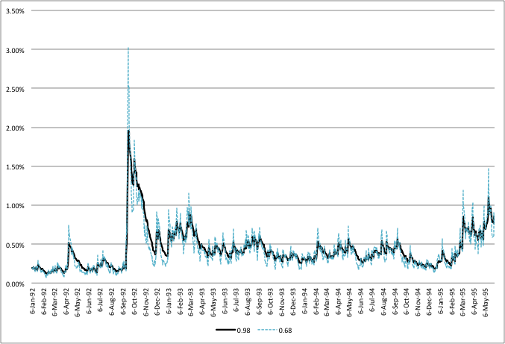
EWMA Estimates of Daily Volatility

Slide 14
GARCH (1,1)
In GARCH (1,1) we let the variance revert to a long-run average variance rate
Weights sum to 1: γ + α + β =1
Setting ω = γV_{L} , we can write:
And:

Slide 15
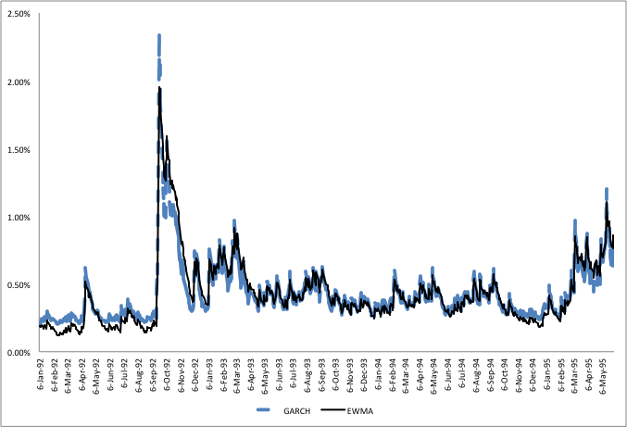
GARCH Estimates vs EWMA

Slide 16
Forecasting Future Volatility
We now ask: What is our prediction for volatility in t days.
If we assume returns are i.i.d. then:
If we assume EWMA:
Since:
We get the same result:
for t=1, and then for all t.

Slide 17
Forecasting Future Volatility with GARCH (1,1)
Since
And
We get by iteration that the expected future daily variance is:
If the daily volatility will be reverting to the long run mean

Slide 18
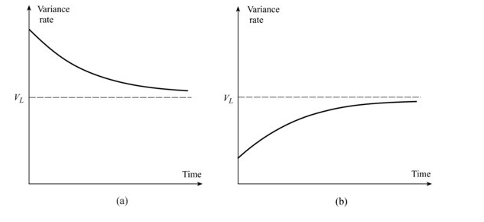
Forecasting Future Volatility cont

Slide 19
Volatility Over T Days
We would like to know the volatility over the next T days.
First, assume that the daily returns on the index are i.i.d. with mean zero and annualized standard deviation of 20%.
What is the volatility of 10-day return?

Slide 20
Volatility Over T Days - GARCH
Now, suppose volatility follows GARCH(1,1) with long term annualized volatility of 15%, α=0.0603, β=0.9001, what is the volatility of 10-day return? Current volatility estimate is 20% p.a.

Slide 21
Volatility Over T Days – GARCH
Convert the variances to daily:
Compute the expected future variances, using:
Sum the variances: 0.001476
10-day volatility is only 3.84%
t | 0 | 1 | 2 | 3 | 4 | 5 | 6 | 7 | 8 | 9
Variance | 0.000159 | 0.000156 | 0.000153 | 0.000151 | 0.000148 | 0.000146 | 0.000144 | 0.000142 | 0.000140 | 0.000138

Slide 22
Average Variance Rate
Instead of summing up discretely, we can integrate over time:
Variance over T days is:
The average daily variance is:

Slide 23
Annualized Average Variance Rate
For pricing an option with T days to maturity we use the annualized average variance over the period.
The variance per year for an option lasting T days is:
and V_{L} are daily. σ(T) is annualized. T in days.
Note:

Slide 24
Example – Option on S&P
Suppose the S&P 500 is currently at 2,020. What is the value of a European option on the index, with 30 days to expiration, K=2,000, r=3%, σ=20%, q=3%?
Black Scholes value is $65.66.
Now, suppose that we estimated a GARCH(1,1) process for the index and found that the long term volatility is 15%, α=0.0603, β=0.9001. What is our estimate of the option’s value?

Slide 25
Example – Option on S&P (2)
First, compute the average annualized volatility:
The Black-Scholes value is now: $60.40.
$5.26 less than with the i.i.d. assumption.

Slide 26
Scenario Analysis
Scenarios may be used to measure the sensitivity of the position value to shocks in underlying parameters.
For example: To estimate the sensitivity of the option to volatility, we can look at the change in value position for increase/decrease of 1% in volatility.
Regulators often require banks to consider what would happen to their portfolio if market volatility increased dramatically overnight.

Slide 27
Scenario Analysis - Example
We want to evaluate the change in value of the option from before, if volatility goes up from 20% to 21%
Assuming returns are i.i.d.
Using GARCH with long term volatility = 15% as before.

Slide 28
Scenario Analysis - Example
At σ=20% the price was $65.66.
Recalculating using σ=21%, price is $68.39.
The value has gone up by 4.15%
Using GARCH: average annualized volatility (aav) is 18.07%, and price is $60.40.
Recalculating using σ=21%, aav is 18.71%, price is $62.16. The value has gone up only by 2.91%

Slide 29
Sensitivity to Volatility
Differentiating the Average Annualized Volatility formula for GARCH (1,1) gives us the sensitivity of average annualized volatility to changes in σ(0) .
When σ(0) changes by Δσ(0), GARCH (1,1) predicts that σ(T) changes by

Slide 30
Thanks

